Slide 1

Inheritance
  A new class is created by acquiring an existing class’s members and possibly embellishing them with new or modified capabilities.
  Can save time during program development by basing new classes on existing proven and debugged high-quality software.
  Increases the likelihood that a system will be implemented and maintained effectively.
  Don’t Repeat Yourself (DRY).
© Copyright 1992-2015 by Pearson Education, Inc. All Rights Reserved.

Slide 2

When creating a class, rather than declaring completely new members, you can designate that the new class should inherit the members of an existing class.
  Existing class is the superclass
  New class is the subclass
A subclass is more specific than its superclass and represents a more specialized group of objects.
The subclass exhibits the behaviors of its superclass and can add behaviors that are specific to the subclass.
  This is why inheritance is sometimes referred to as specialization.
© Copyright 1992-2015 by Pearson Education, Inc. All Rights Reserved.

Slide 3
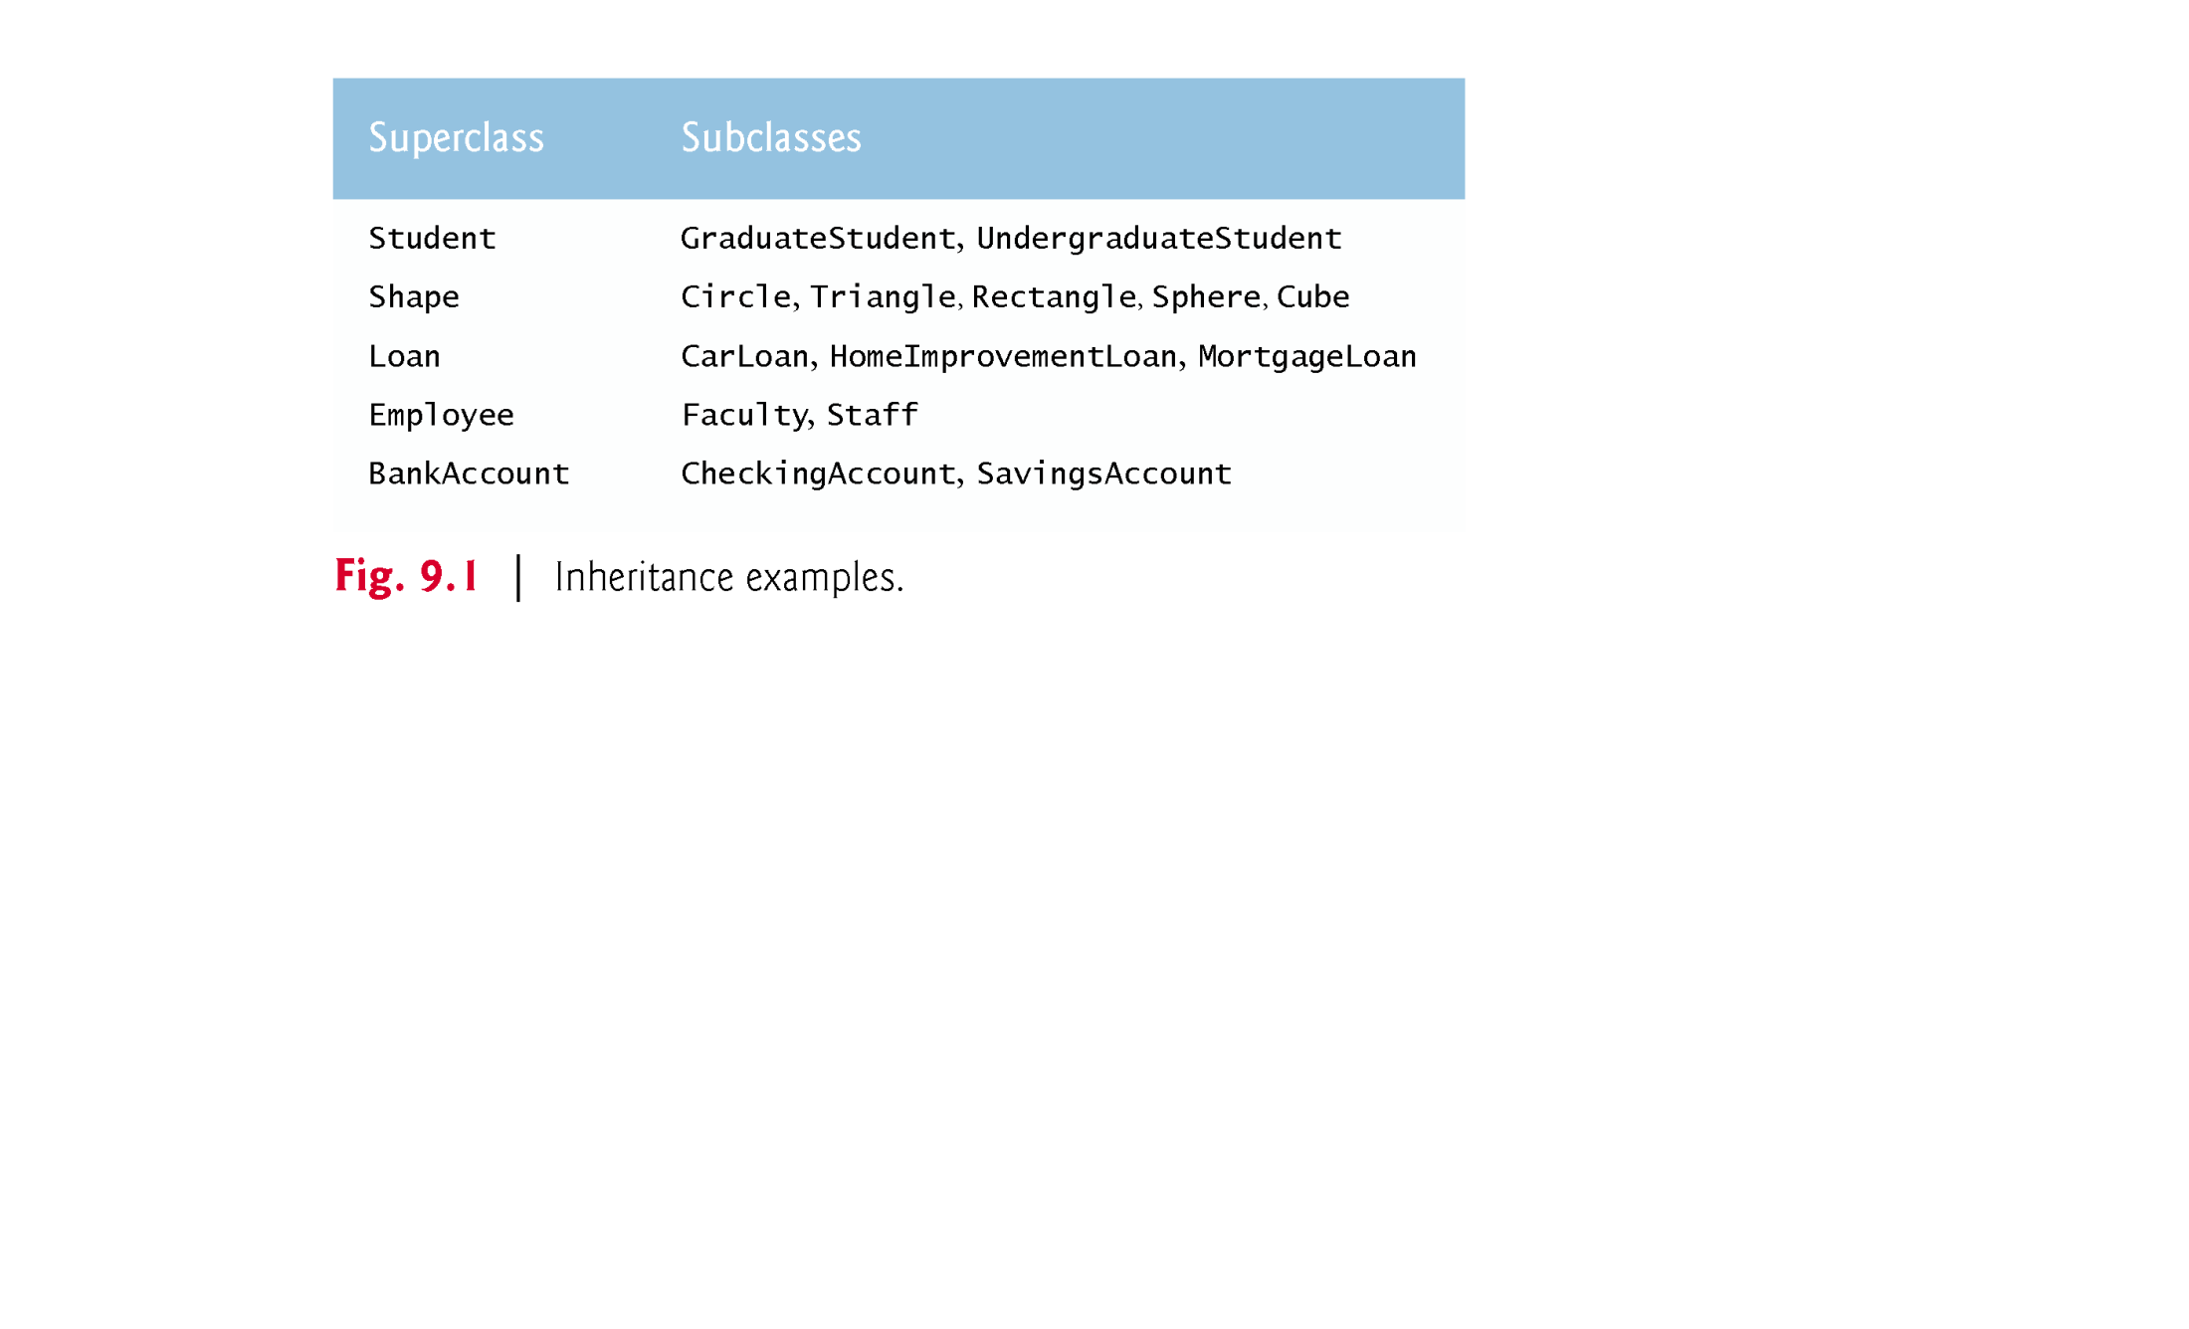
© Copyright 1992-2015 by Pearson Education, Inc. All Rights Reserved.

Slide 4
The Java class hierarchy begins with class Object (in package java.lang)
  Every class in Java directly or indirectly extends (or “inherits from”) Object.
Java supports only single inheritance, in which each class is derived from exactly one direct superclass.
© Copyright 1992-2015 by Pearson Education, Inc. All Rights Reserved.

Slide 5

Class CommissionEmployee (Fig. 9.4) extends class Object (from package java.lang).
  CommissionEmployee inherits Object’s methods.
  If you don’t explicitly specify which class a new class extends, the class extends Object implicitly.
© Copyright 1992-2015 by Pearson Education, Inc. All Rights Reserved.

Slide 6
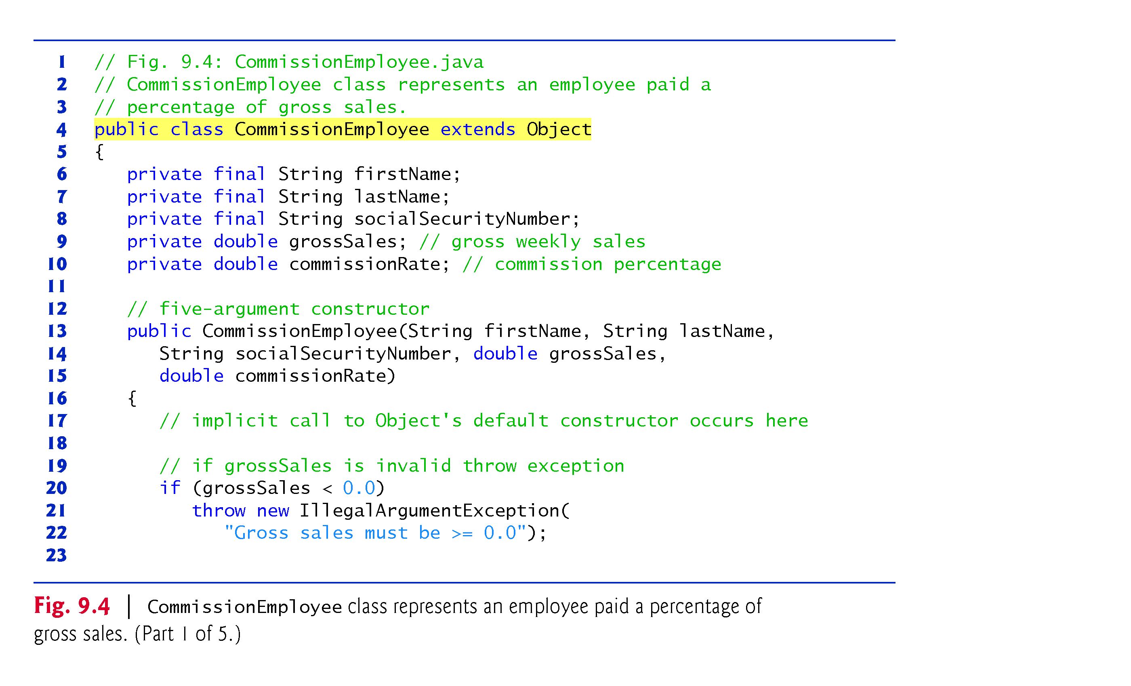
© Copyright 1992-2015 by Pearson Education, Inc. All Rights Reserved.

Slide 7
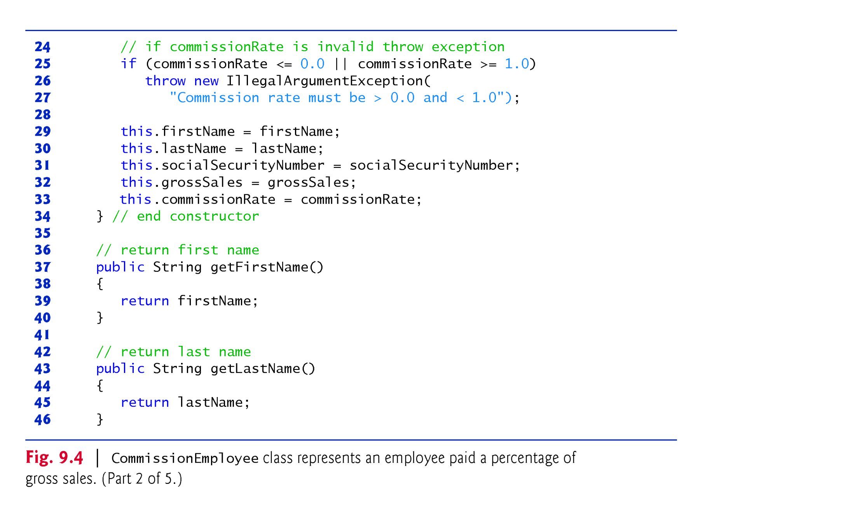
© Copyright 1992-2015 by Pearson Education, Inc. All Rights Reserved.

Slide 8
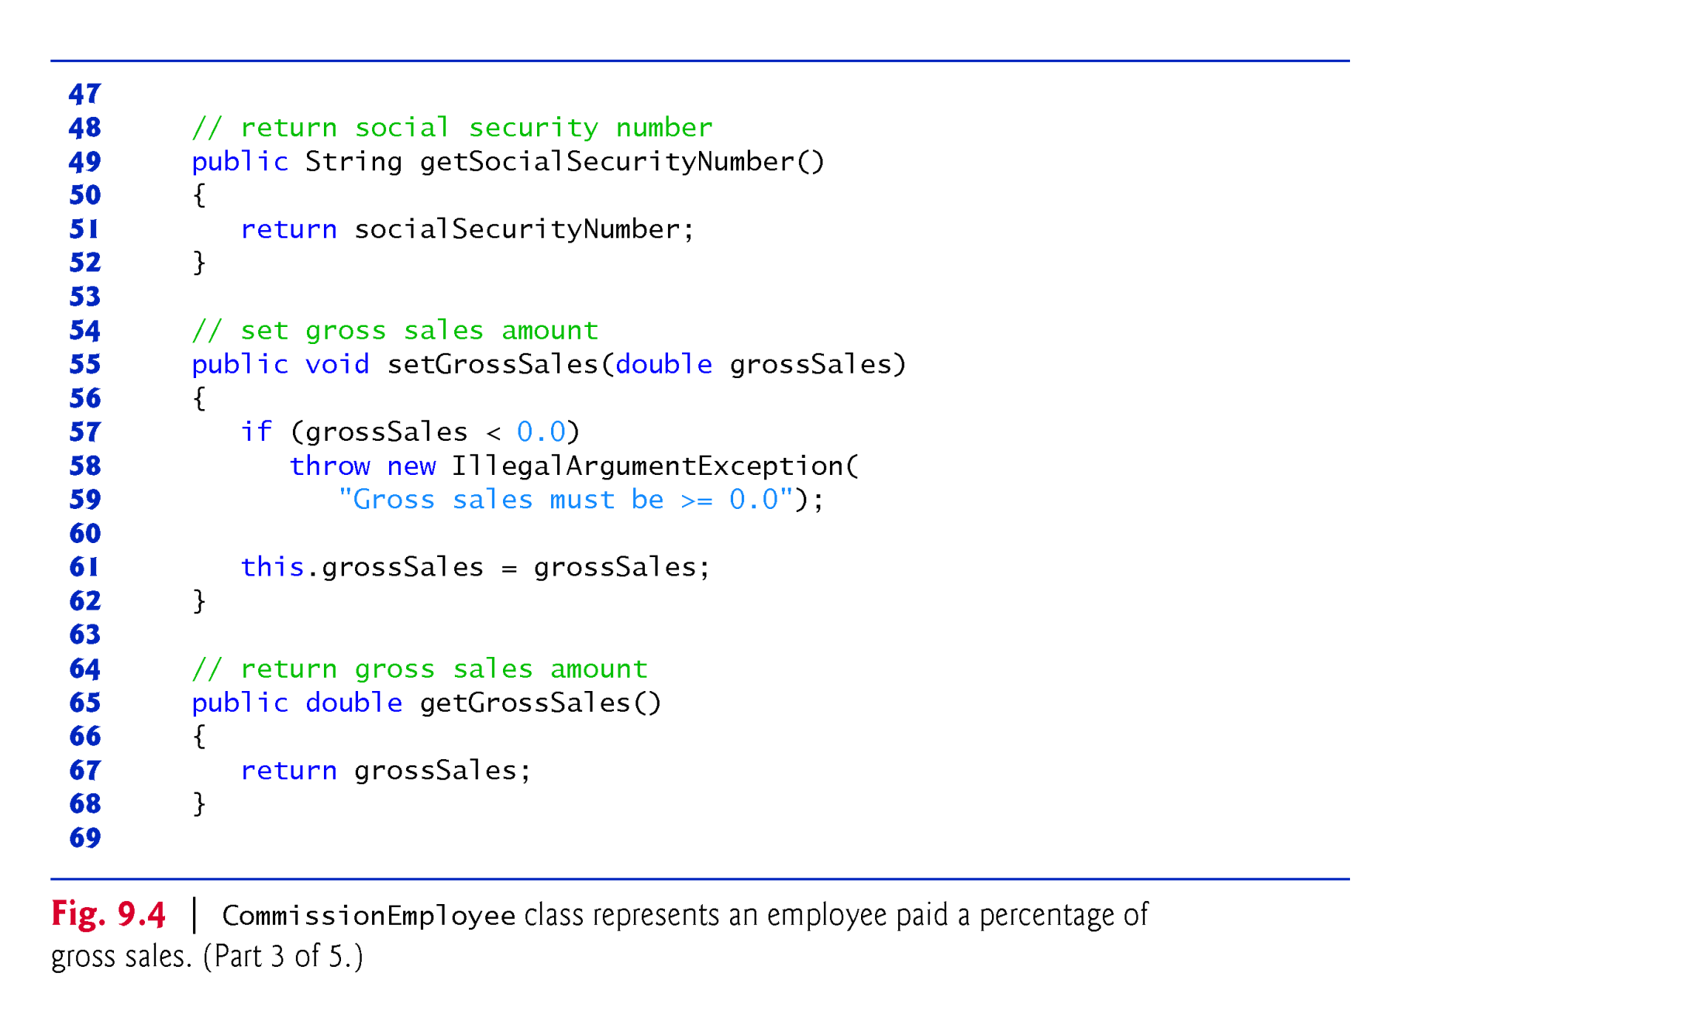
© Copyright 1992-2015 by Pearson Education, Inc. All Rights Reserved.

Slide 9
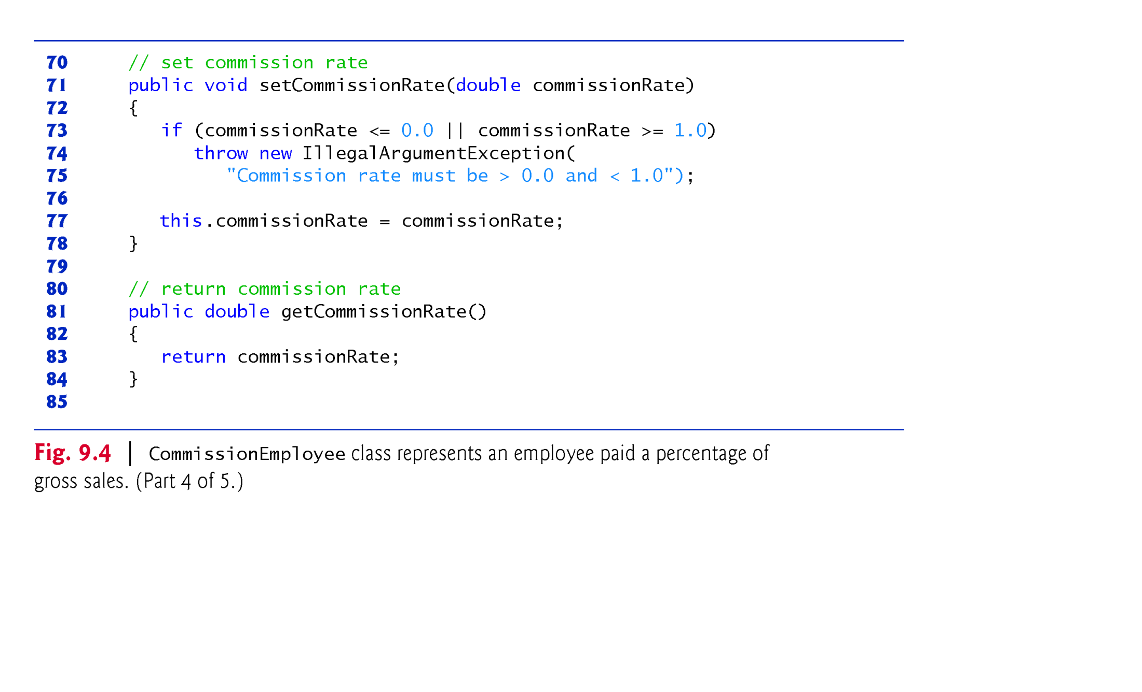
© Copyright 1992-2015 by Pearson Education, Inc. All Rights Reserved.

Slide 10
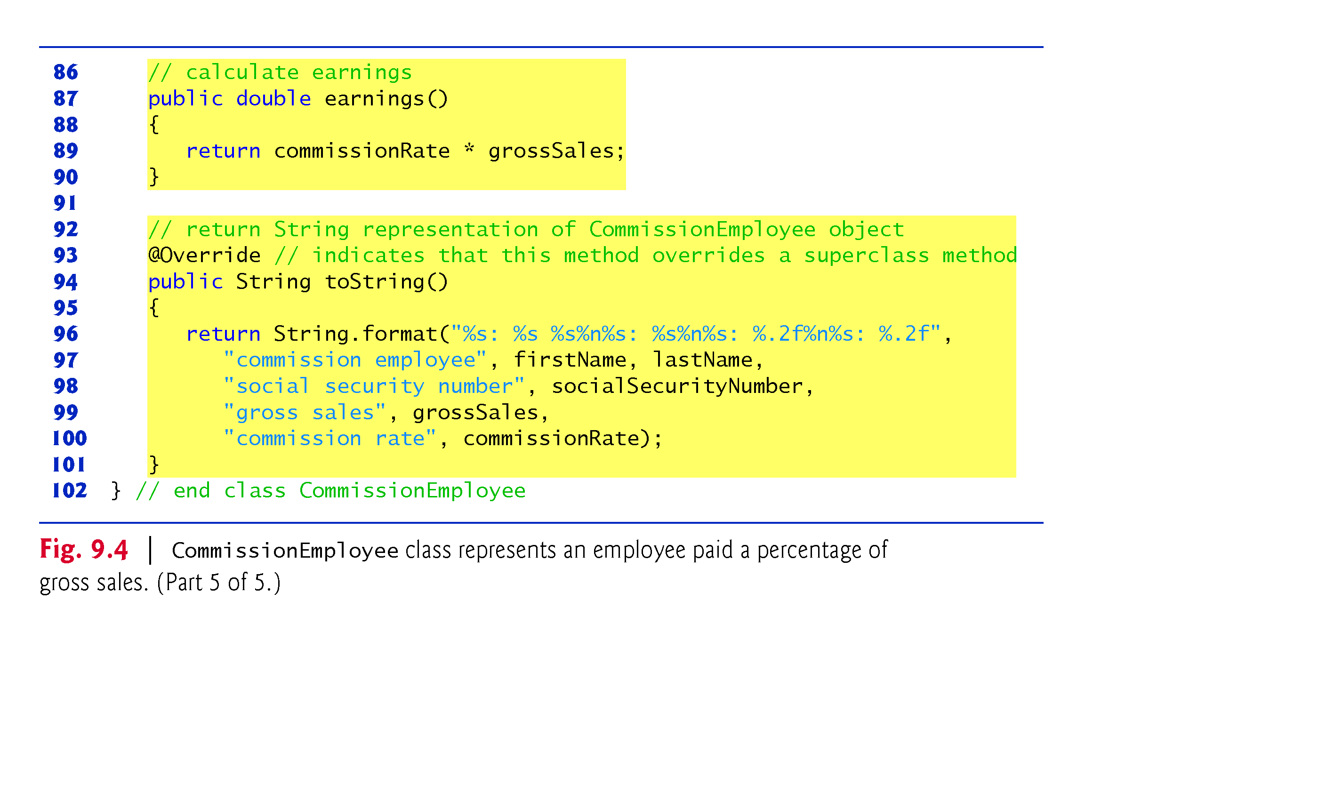
© Copyright 1992-2015 by Pearson Education, Inc. All Rights Reserved.

Slide 11
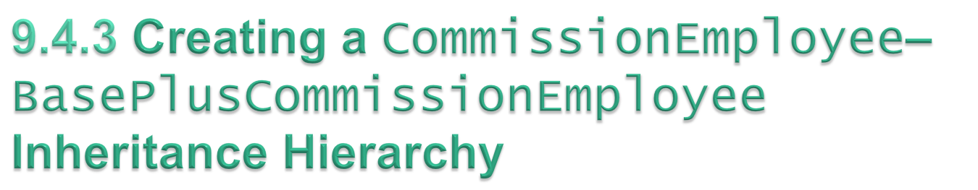
Class BasePlusCommissionEmployee class extends class CommissionEmployee
A BasePlusCommissionEmployee object is a CommissionEmployee
  Inheritance passes on class CommissionEmployee’s capabilities.
Class BasePlusCommissionEmployee also has instance variable baseSalary.
Subclass BasePlusCommissionEmployee inherits CommissionEmployee’s instance variables and methods
  Only CommissionEmployee’s public and protected members are directly accessible in the subclass.
© Copyright 1992-2015 by Pearson Education, Inc. All Rights Reserved.

Slide 12
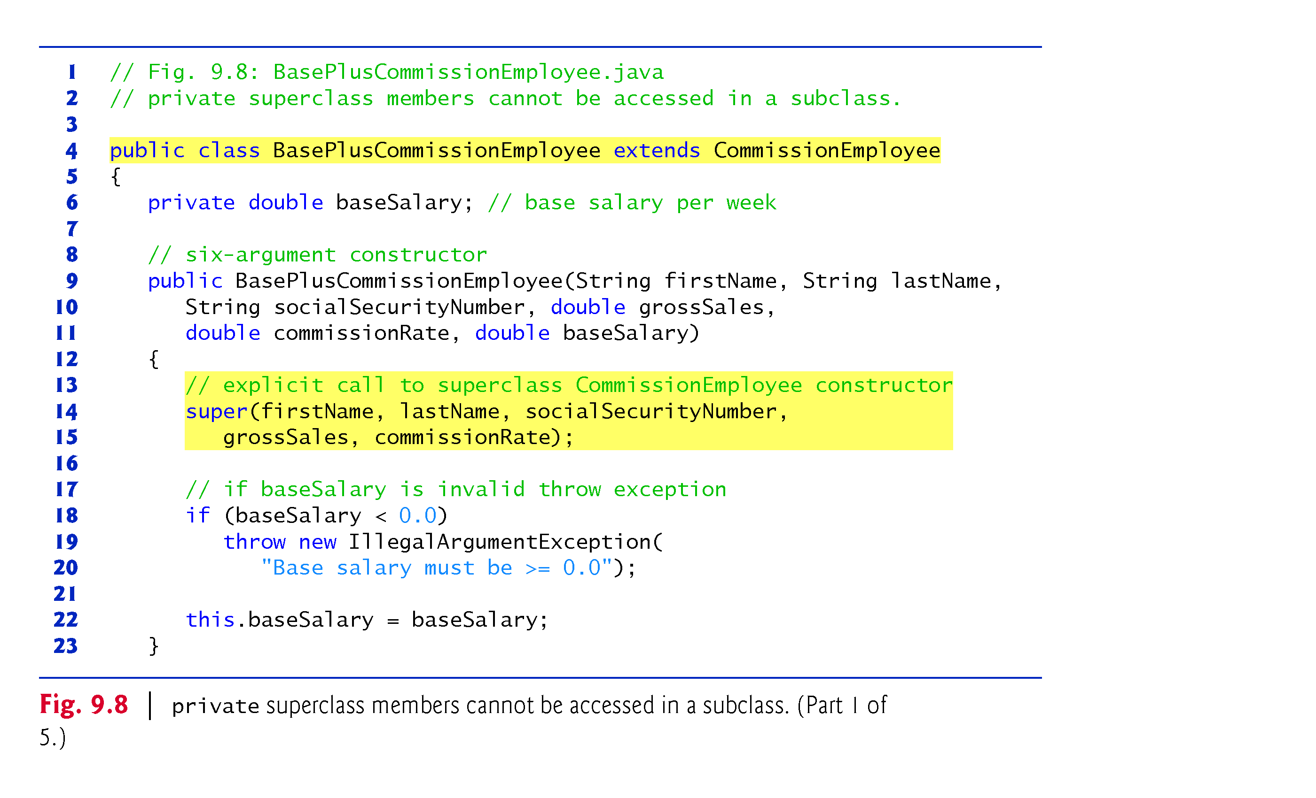
© Copyright 1992-2015 by Pearson Education, Inc. All Rights Reserved.

Slide 13
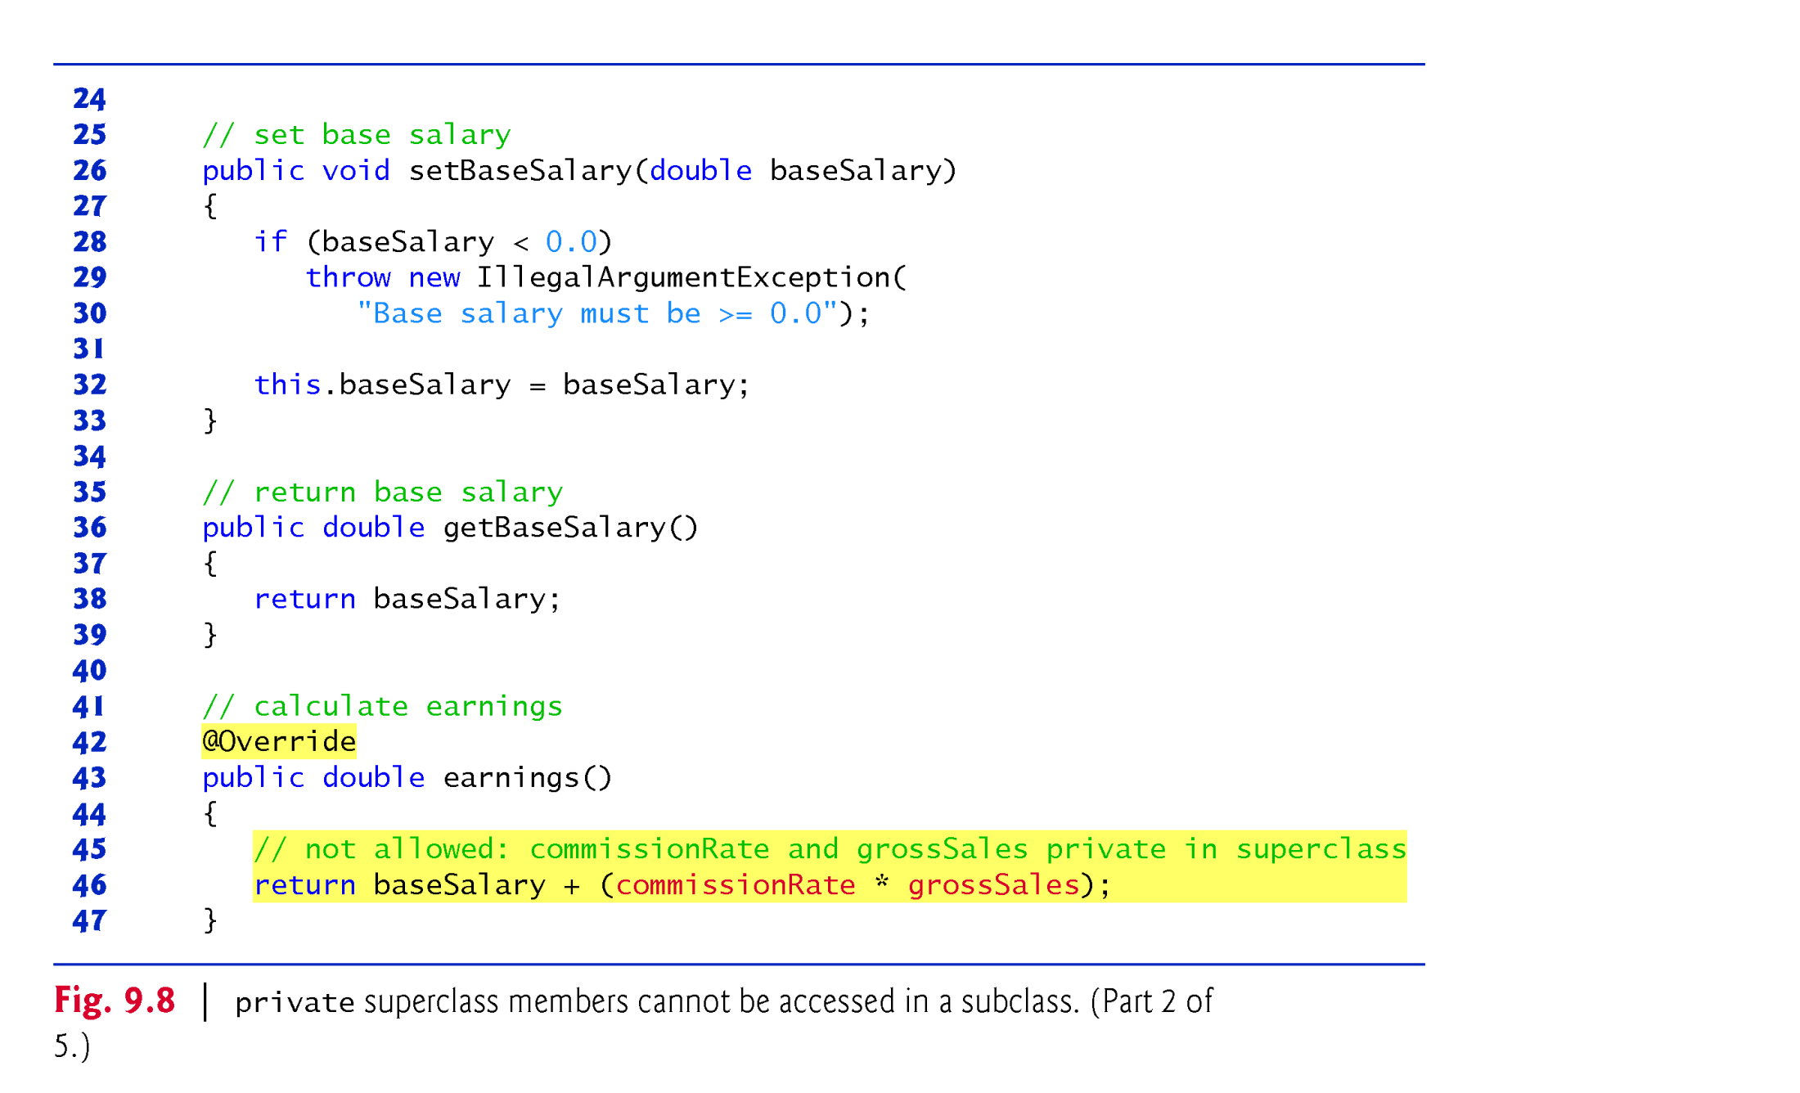
© Copyright 1992-2015 by Pearson Education, Inc. All Rights Reserved.

Slide 14
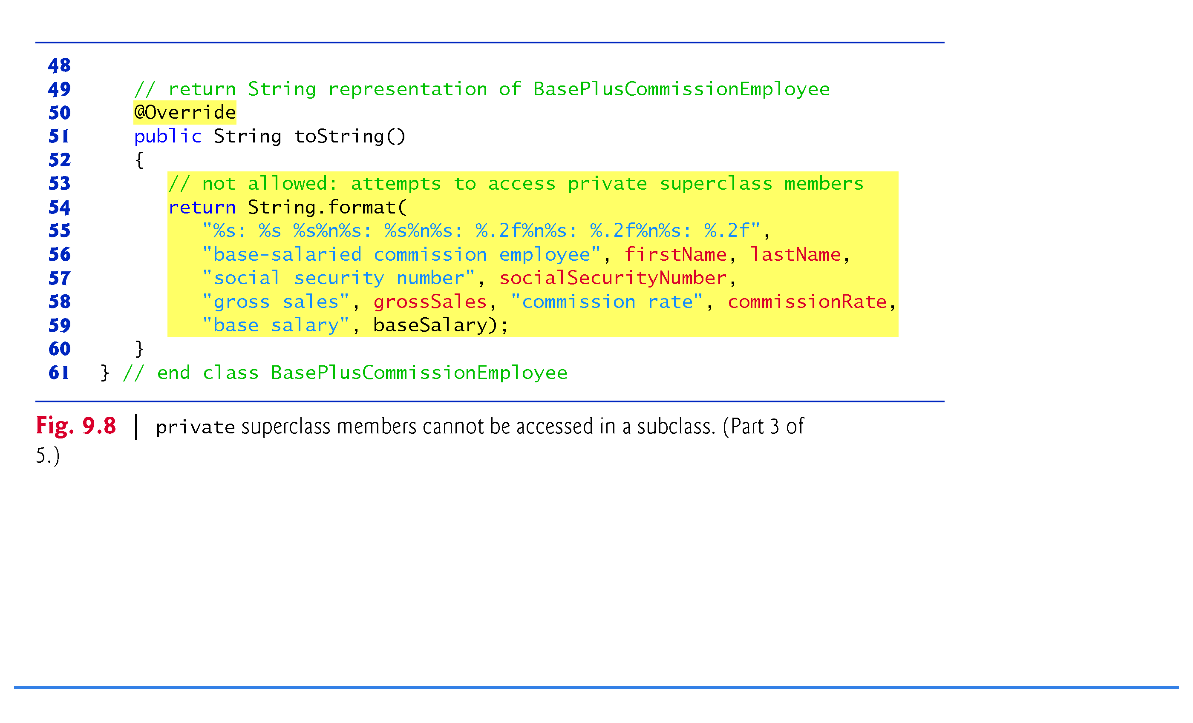
© Copyright 1992-2015 by Pearson Education, Inc. All Rights Reserved.

Slide 15
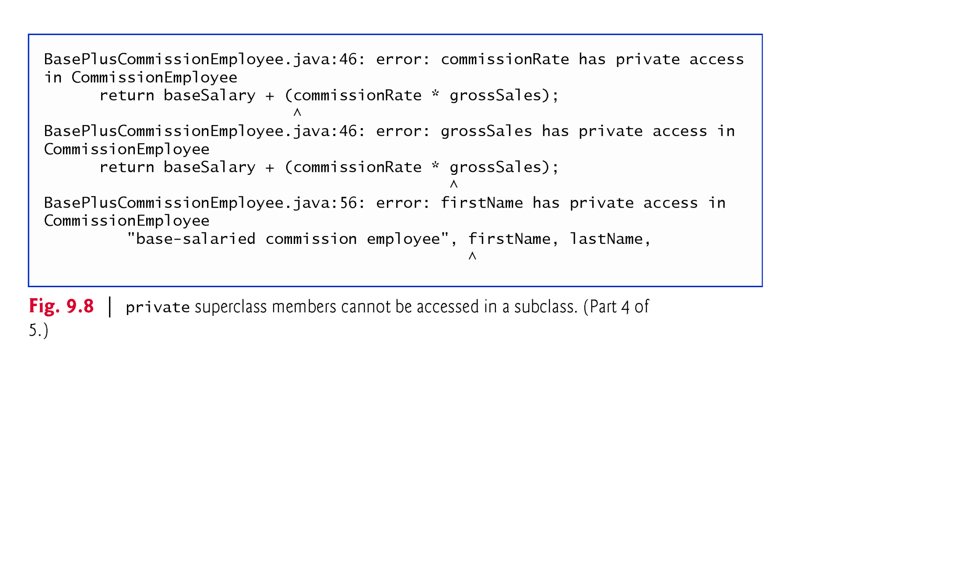
© Copyright 1992-2015 by Pearson Education, Inc. All Rights Reserved.

Slide 16
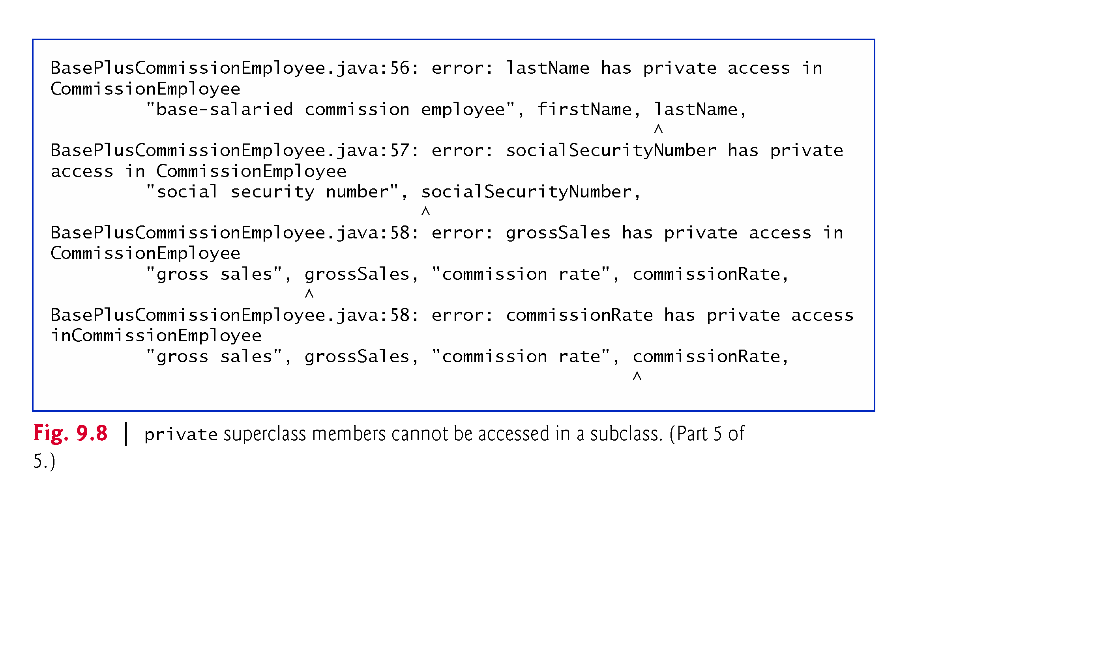
© Copyright 1992-2015 by Pearson Education, Inc. All Rights Reserved.

Slide 17
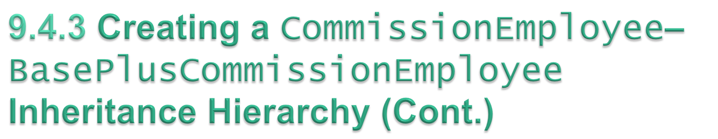
Compilation errors occur when the subclass attempts to access the superclass’s private instance variables.
These lines could have used appropriate get methods to retrieve the values of the superclass’s instance variables.
© Copyright 1992-2015 by Pearson Education, Inc. All Rights Reserved.

Slide 18

To enable a subclass to directly access superclass instance variables, we can declare those members as protected in the superclass.
New CommissionEmployee class modified only lines 6–10 of Fig. 9.4 as follows:
    protected final String firstName;
    protected final String lastName;
    protected final String socialSecurityNumber;
    protected double grossSales;
    protected double commissionRate;
With protected instance variables, the subclass gets access to the instance variables, but classes that are not subclasses and classes that are not in the same package cannot access these variables directly.
© Copyright 1992-2015 by Pearson Education, Inc. All Rights Reserved.

